Slide 1
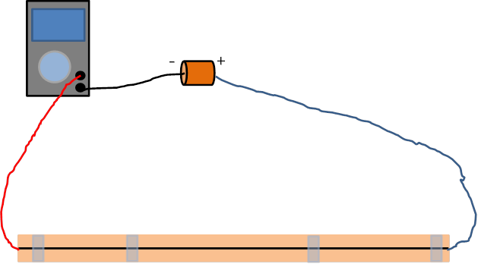
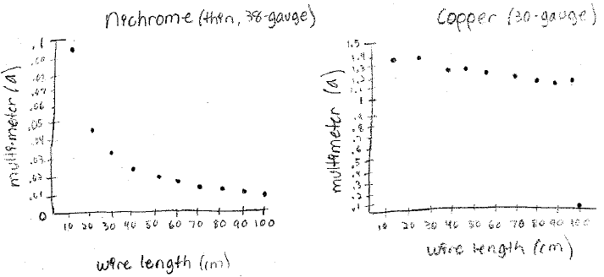
Electrical Conductivity in Materials Santeri Potticary Mason High School, Statistics
RET is funded by the National Science Foundation, grant # EEC 0808696.
Unit Overview
Unit Activity Implementation
Student Work
Topic: Experimental Design
Standards:
CCSS.MATH.CONTENT.HSS.ID.B.6.A Fit a function to the data; use functions fitted to data to solve problems in the context of the data. Use given functions or choose a function suggested by the context.
CCSS.MATH.CONTENT.HSS.ID.B.6.C Fit a linear function for a scatter plot that suggests a linear association.
CCSS.MATH.CONTENT.HSS.ID.C.7 Interpret the slope (rate of change) and the intercept (constant term) of a linear model in the context of the data.
CCSS.MATH.CONTENT.HSS.ID.C.8 Compute (using technology) and interpret the correlation coefficient of a linear fit.
CCSS.MATH.CONTENT.HSS.ID.C.9 Distinguish between correlation and causation.
Before the activity, each student completed a pre-assessment. Next, a series of eight pictures were presented showing a variety of devices such as planes, cars, laptops, cordless drills, and the Mars Curiosity rover alongside the question “What do all of these items have in common?” The answer is they all use lithium-ion batteries. This is followed by a discussion about the material properties that affect electrical conductivity as well the need for lighter, cheaper, or even flexible batteries.
Each student is then given a worksheet discussing the objective of the experiment and the statistical elements of Experimental Design. They are supplied with wires of different gages and materials, a battery, a meter stick, and a multimeter. The current in the wires is measured every ten centimeters and recorded. This data is then plotted in a scatterplot and a line of best fit is calculated. The data is then interpreted and conclusions are made.
Assessment Results:
Impact on Student Learning
Activity Structure
This activity was performed as a review of previously learned material and this was seen in the results of the pre- and post-assessment; many of the students performed well on both. Instead of reviewing material from the book or previous work, this provided a new perspective in order to help solidify concepts in preparation for a test. At the same time, it introduced concepts of materials engineering and engineering design.
Title: Electrical Conductivity in Materials
Guiding Questions:
Why is energy storage important?
What properties are important to energy storage?
How can type of material affect conductivity?
What parameters (thickness, length, temperature, type of material) affect conductivity?
Is cost an issue?
Objectives:
Students will be able to measure electrical resistance in a wire.
Students will be able to identify properties affecting resistance.
Students will understand and be able to apply the components of experimental design.
Students will be able to analyze experimental results statistically.
Engineering Design Process
Students are encouraged to think about the properties affecting the development of battery technology. An experiment is used to identify effects of properties. Having an understanding of how materials behave before using them in a design is important. Identifying problems and constraints are early steps in the design process.
ACS (Applications, Careers, Society):
Statistics used to determine material properties from an experiment shows application of math in engineering
Pictures show technology so students understand that classroom concepts can lead to exciting careers in product development
Airplane fires caused buy lithium-ion batteries show societal impact of understanding material properties
Reflection and Conclusion
The overall activity worked well and students were engaged. The part of the activity where the effect of temperature on conductivity was to be tested did not work but this led to the students learning more about experimental design as we discussed the reasons that this did not work. It incorporated critical thinking into the activity. Many concepts were covered such as the reasons for collecting data, how to collect data, how to set up an experiment, and how to analyze the data using statistical concepts. This activity demonstrated how statistics can be used in a real life situation to determine the effects of material properties.

